Slide 1

Customer Shopping Behavior Analysis
Data-driven insights using Python, SQL Server, and Power BI — Jalan Parth Santosh

Slide 2

Business Problem
The company needs a clear understanding of customer shopping behavior to increase sales, boost loyalty, and improve satisfaction. Recent shifts were observed across demographics, discount usage, and product categories.
Primary question: How can customer data reveal trends to enhance engagement and revenue?
Focus areas: demographic trends, discount effects, product performance.

Slide 3
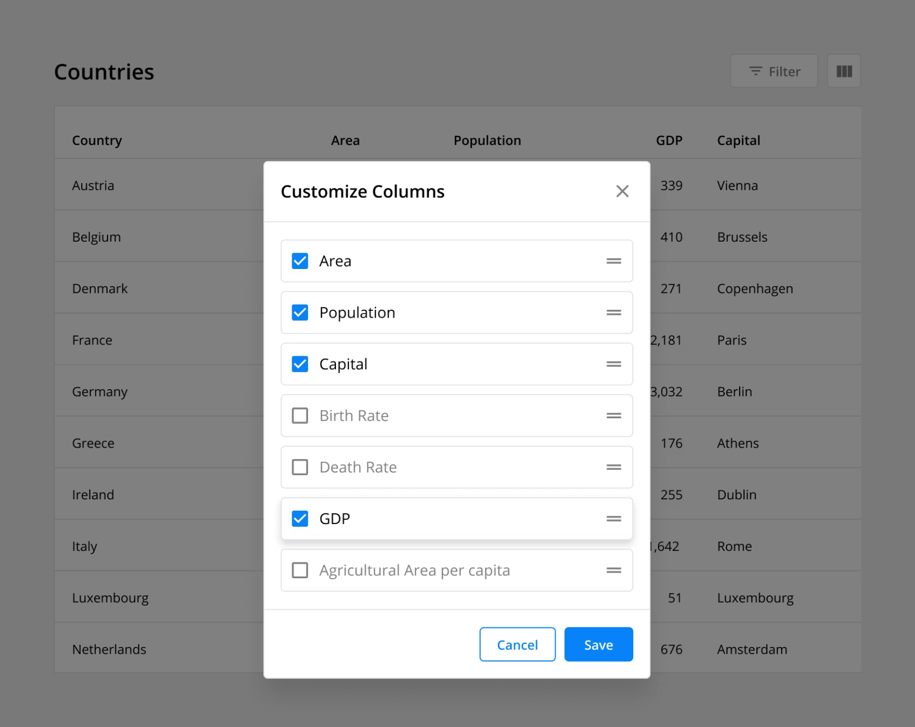
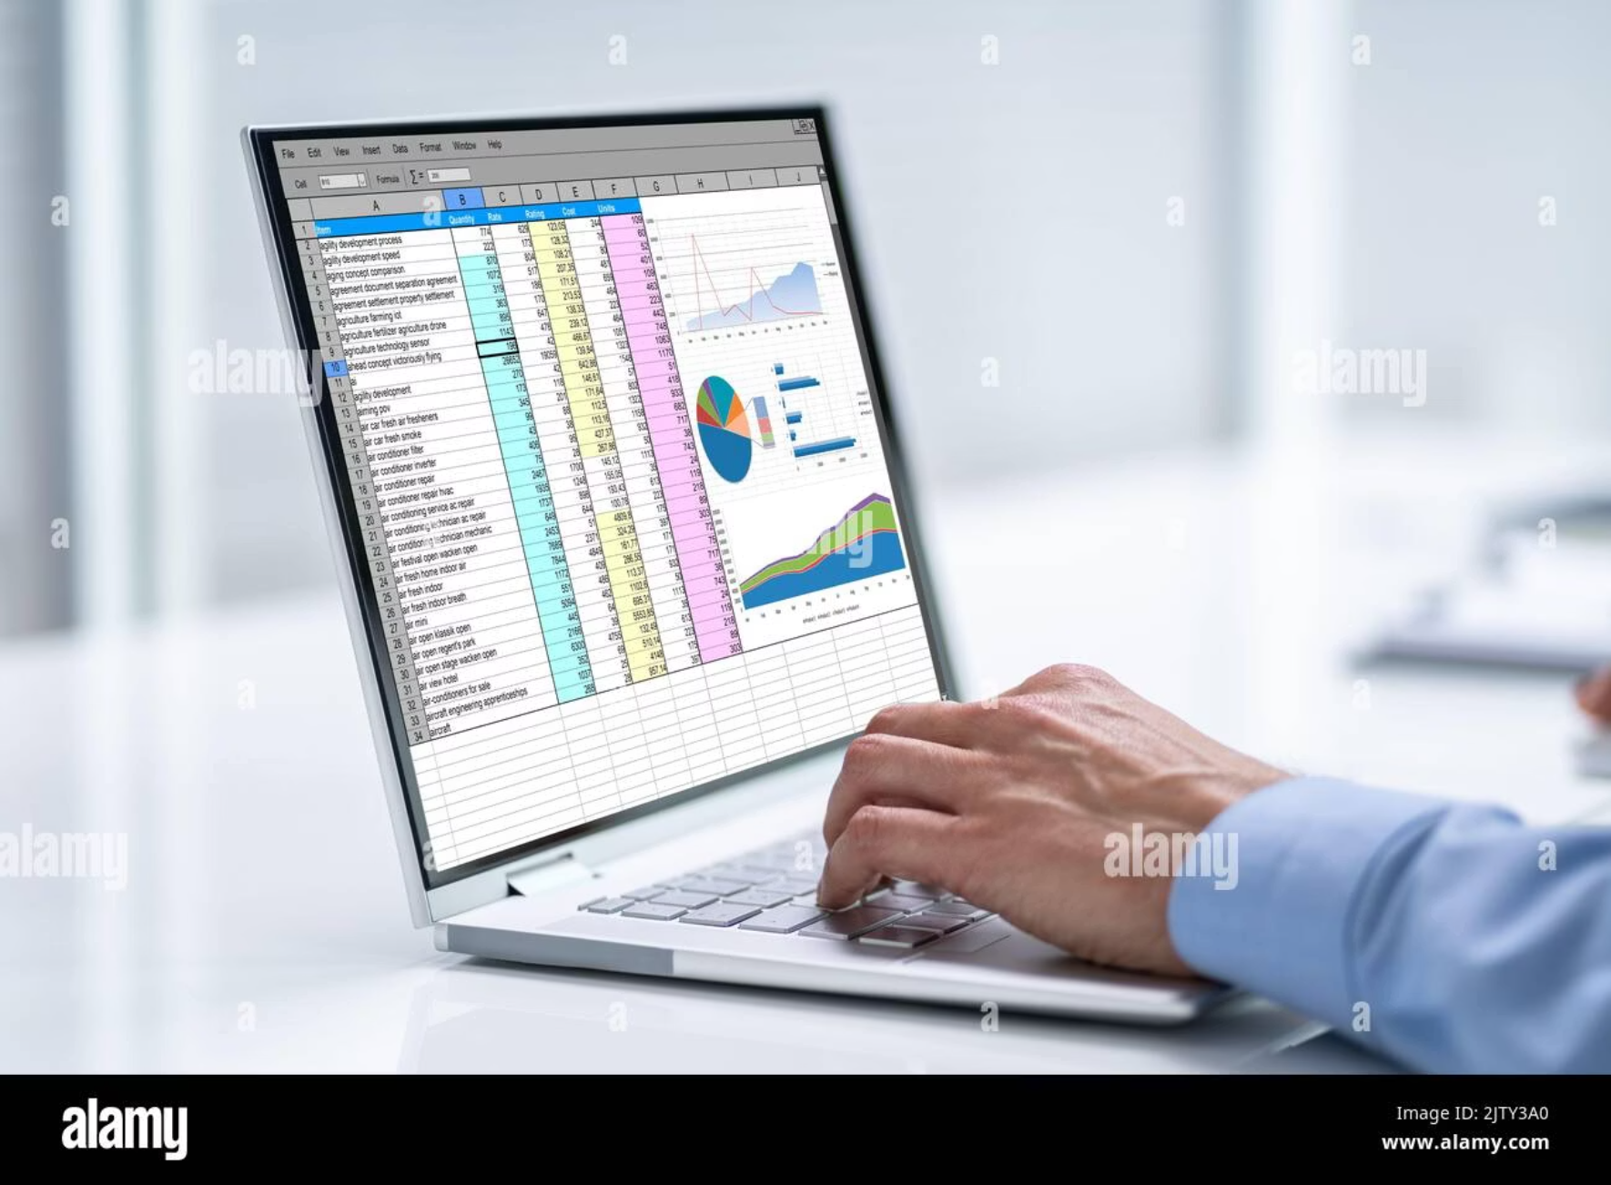
Dataset Overview
Core dataset: 3,900 records and 18 columns with fields such as Age, Gender, Category, Purchase Amount, Season, Review Rating, and Subscription Status.
Data issues addressed: missing review ratings, a redundant promo code column.
Result: cleaned, standardized, analysis-ready data.

Slide 4

Tools & Technologies
Python
SQL Server
Pandas and NumPy for cleaning, transformation, and feature engineering.
Centralized querying and structured analysis for aggregated metrics.
SQLAlchemy
Power BI
Reliable database connectivity and ETL integration.
Interactive dashboards for stakeholders and exploratory visualizations.

Slide 5

Data Preparation (Python)
Loaded and profiled the dataset to assess completeness and distributions.
Imputed missing review ratings using median values within product categories.
Standardized column names to snake_case and removed a redundant promo_code column.
Engineered features: age_group (segmentation) and purchase_frequency_days (recency/frequency proxy).

Slide 6
SQL Analysis
Connected the cleaned dataset to SQL Server to run scalable aggregations and segment queries.
Revenue by Demographics
Product Ratings
Aggregated revenue by gender and age_group to identify high-value cohorts.
Identified top-rated products by average review_rating for merchandising focus.
Customer Segmentation
Promotion & Shipping Impact
Classified customers as New, Returning, or Loyal based on purchase history.
Assessed how discounts and shipping type influence purchase frequency and AOV.

Slide 7
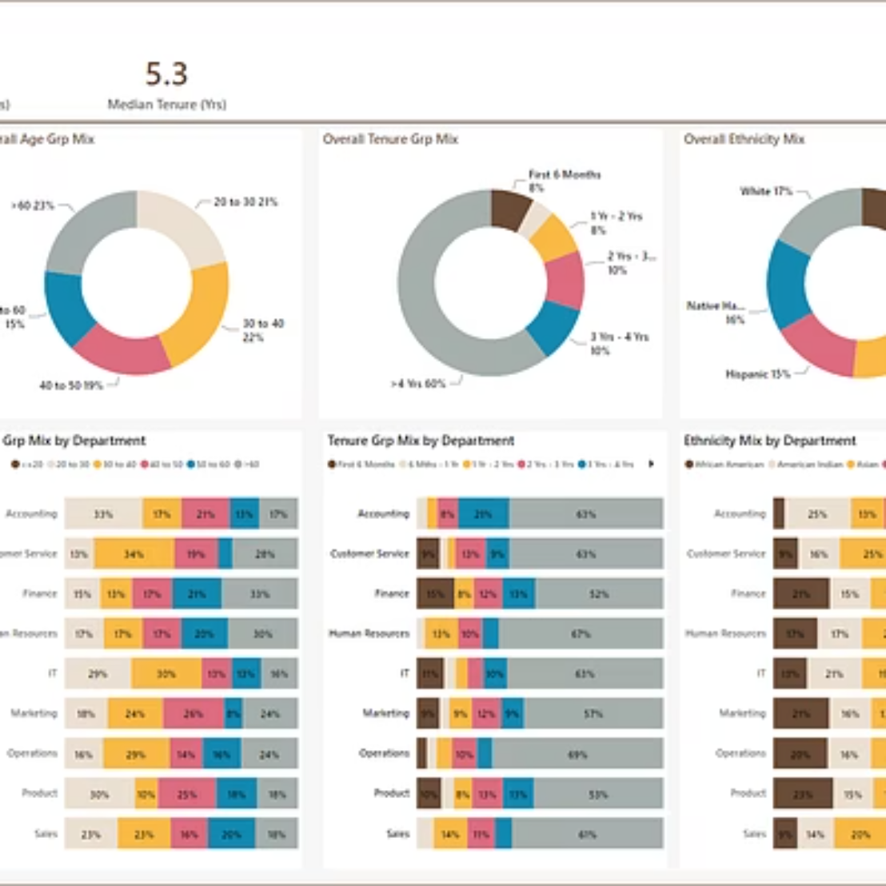
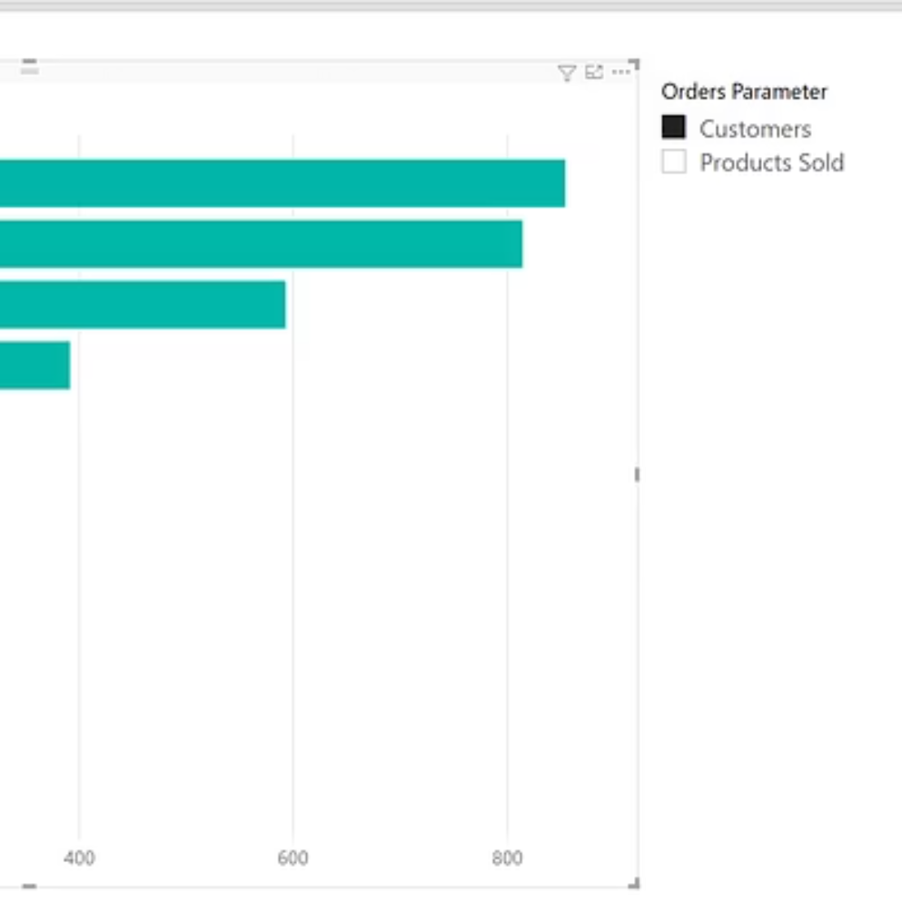
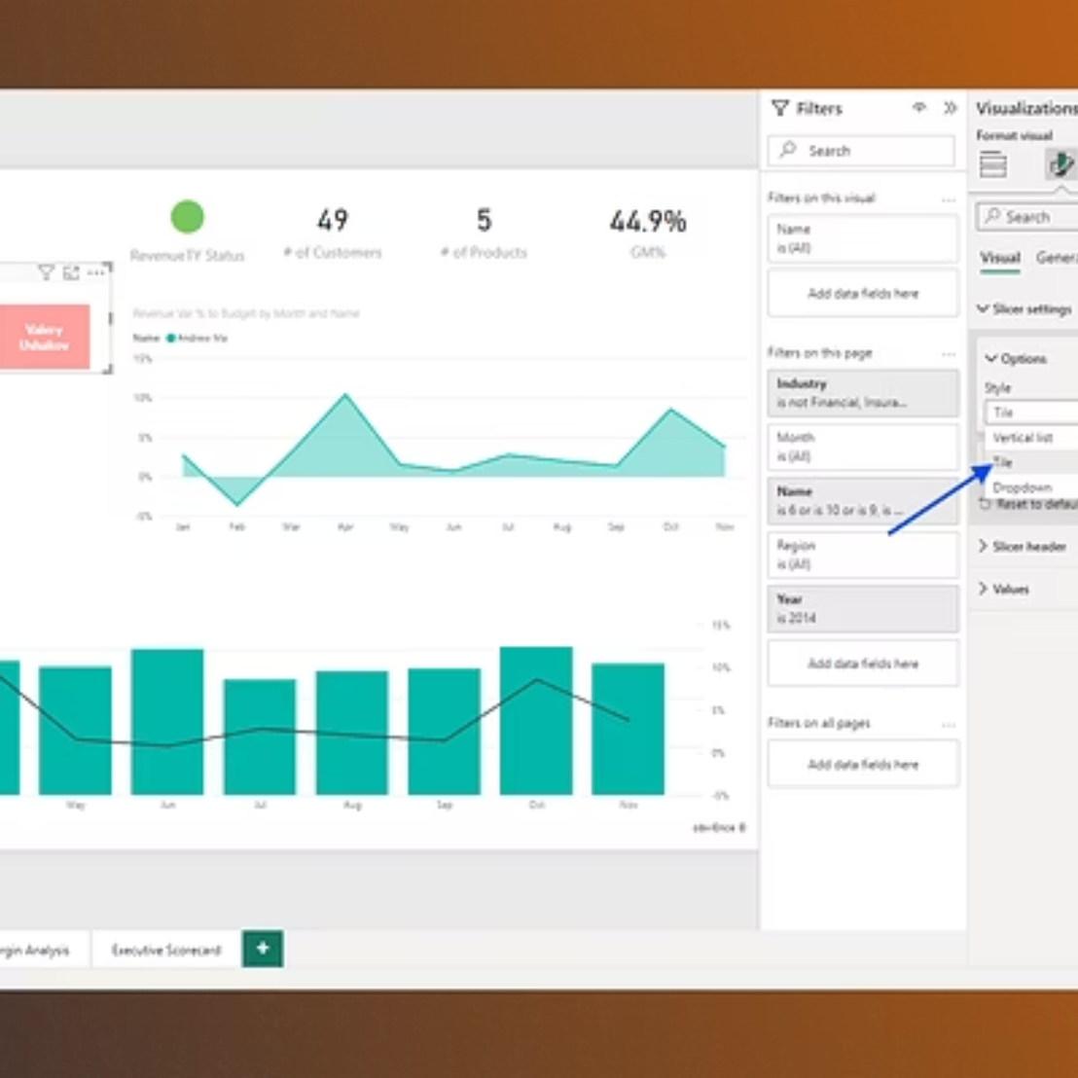
Power BI Dashboard
Interactive dashboard highlights key dimensions for business decisions and stakeholder exploration.
Key views: revenue by age/gender, category performance, discount impact, segment distribution, spending by shipping type.

Slide 8
Key Insights
Revenue Concentration
Adult and Middle-Aged segments account for the largest share of revenue — prioritize retention and upsell.
Shipping & Spend
Express shipping customers exhibit higher average order values than standard shipping users.
Gender Trends
Female customers show higher average purchase amounts across multiple categories.
Value of Loyal Customers
Loyal customers are fewer in number but generate disproportionately high total revenue.
Category Signals
Apparel leads in order volume and discount utilization — evaluate margin effects and targeting.

Slide 9
Business Recommendations
1. Loyalty & Rewards
Design tiered rewards to retain high-value customers and increase repeat frequency among adults and middle-aged cohorts.
2. Discount Optimization
Refine discounts by category and customer segment to protect margins while driving conversion.
3. Merchandising
Feature top-rated products prominently to drive conversion and leverage social proof.
4. Targeted Marketing
Allocate ad spend toward adult and middle-aged segments with personalized creative and channel mix.
5. Shipping & Subscription Offers
Promote express shipping upgrades and subscription bundles with exclusive benefits to lift AOV.

Slide 10

Conclusion
This project combined Python, SQL Server, and Power BI to produce actionable insights that support revenue growth, improved loyalty, and better customer experiences.
Data-driven strategies enable targeted retention and profitable discounting.
Dashboards provide ongoing monitoring and decision support for stakeholders.
Next steps: Pilot loyalty mechanics, run controlled discount experiments, and iterate dashboard KPIs with stakeholder input.

